Slide 1
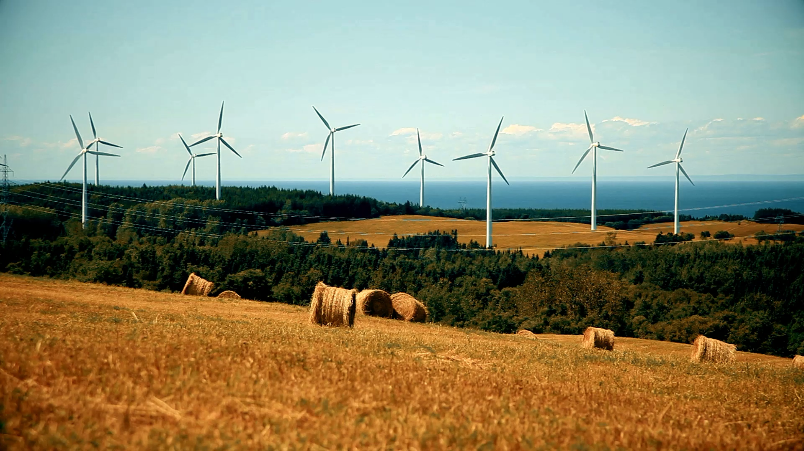
Sustainable Energy and Environmental Impacts
ZI-HAO SHANG
530210753

Slide 2
Analysis Problems
How to improve energy efficiency?
How to reduce environmental impact?
How to improve electricity access between urban and rural areas?

Slide 3
Analysis Streams
1.Energy Consumption
2. Environmental Impact
3. Electricity Access

Slide 4
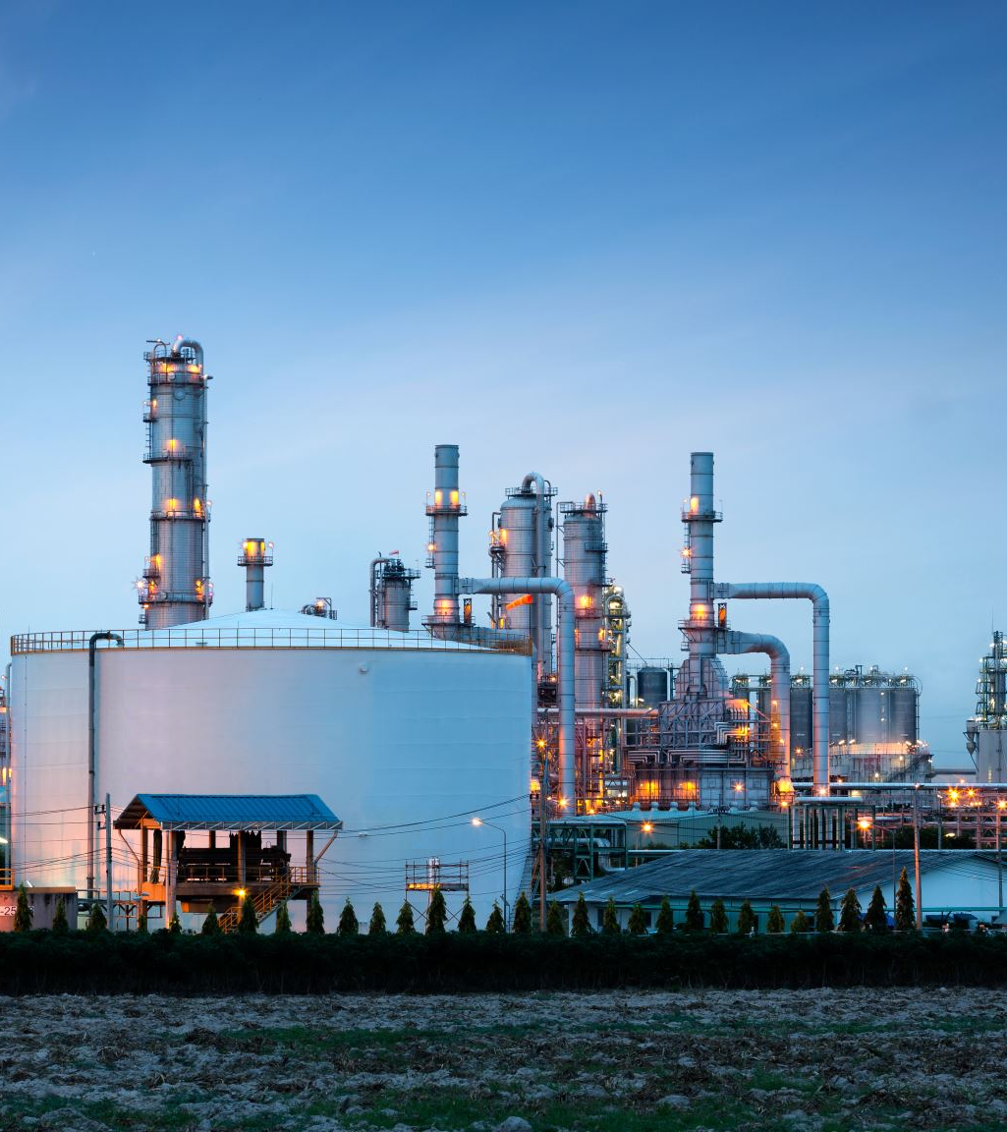
1.Energy Consumption Analysis

Slide 5
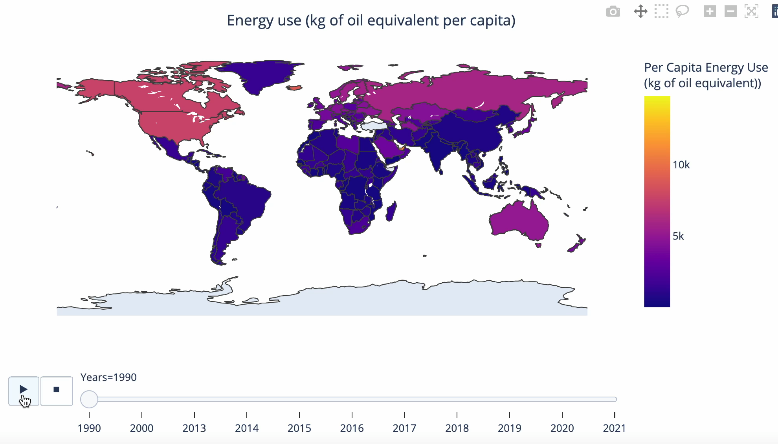
1. Global Energy Consumption Overview

Slide 6
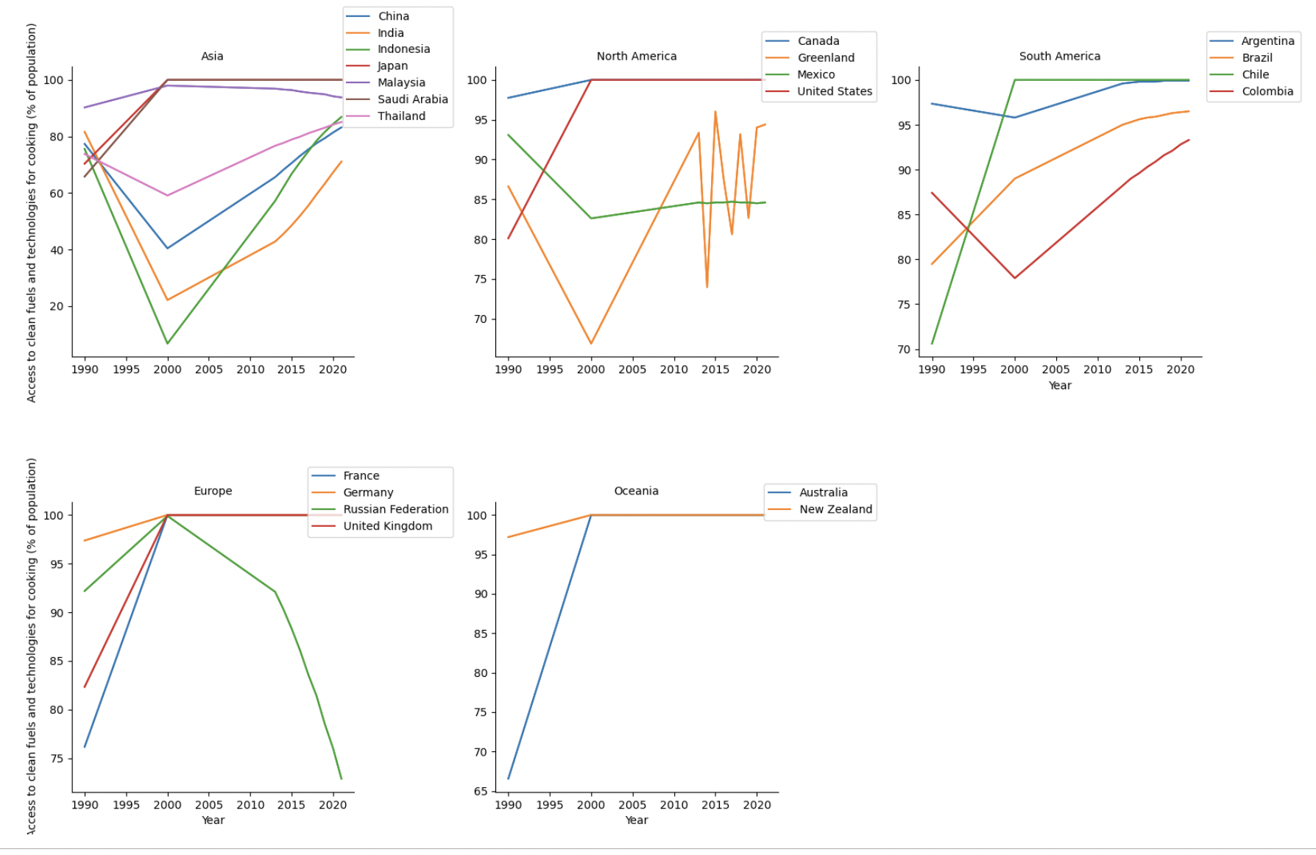
Clean Fuel and Technologies Access Rate (1990-2021)

Slide 7
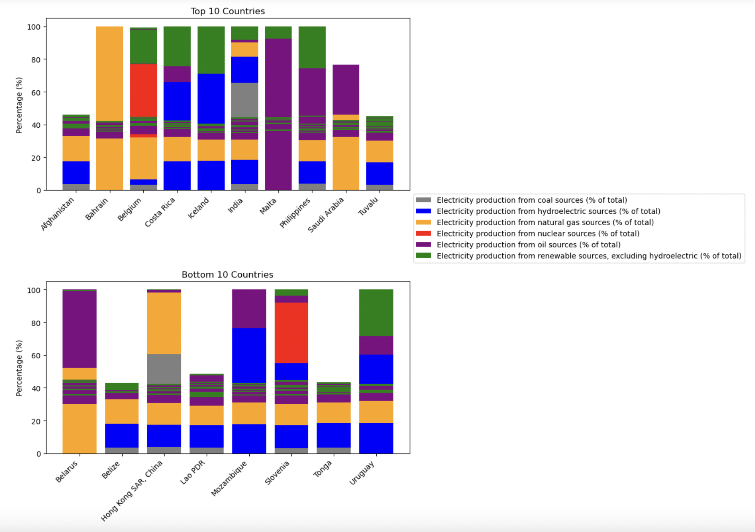
Electricity Production from Different Sources (Top 10 & Bottom 10 countries)

Slide 8
Action Recommendations
To implement diversified energy strategies
To greater investment in sustainable energy technologies
To strengthen international cooperation

Slide 9

2. Environmental Impact Analysis

Slide 10
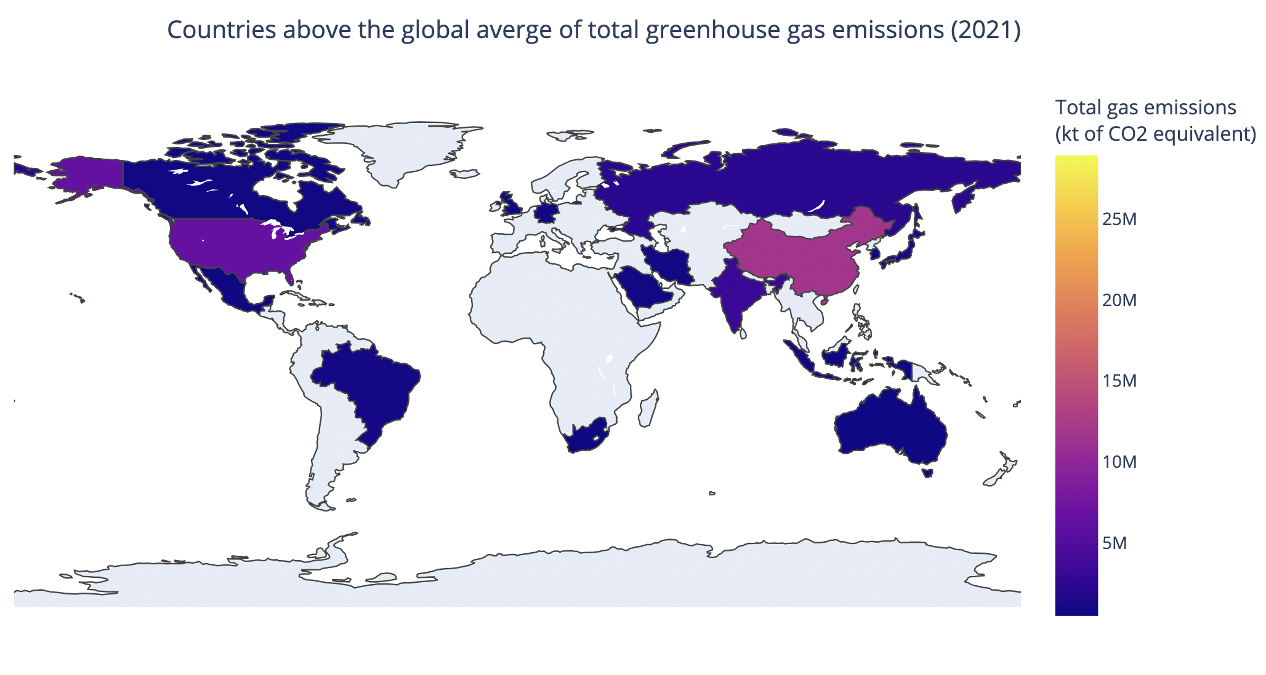
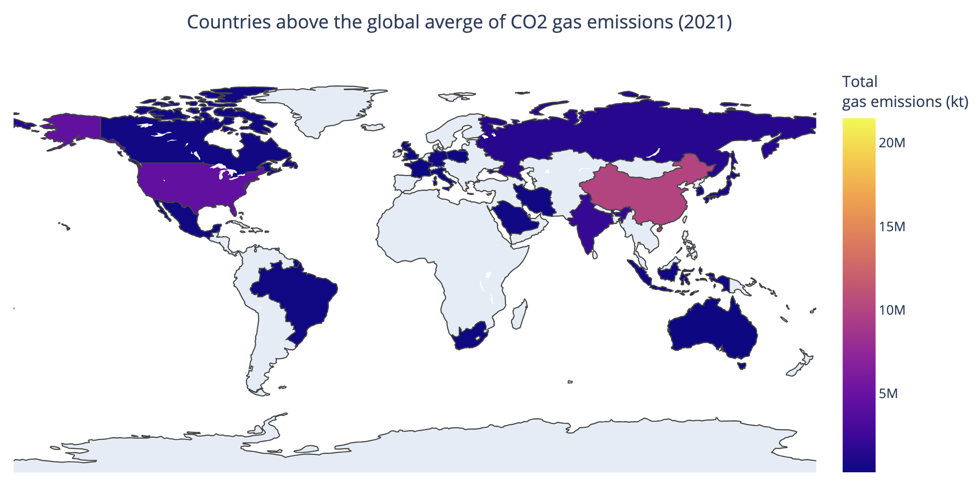
Global Greenhouse Gas Emission
Global average of Greenhouse
= 428723 (kt of CO2 equivalent)
Global average of CO2 =291454 (kt)

Slide 11
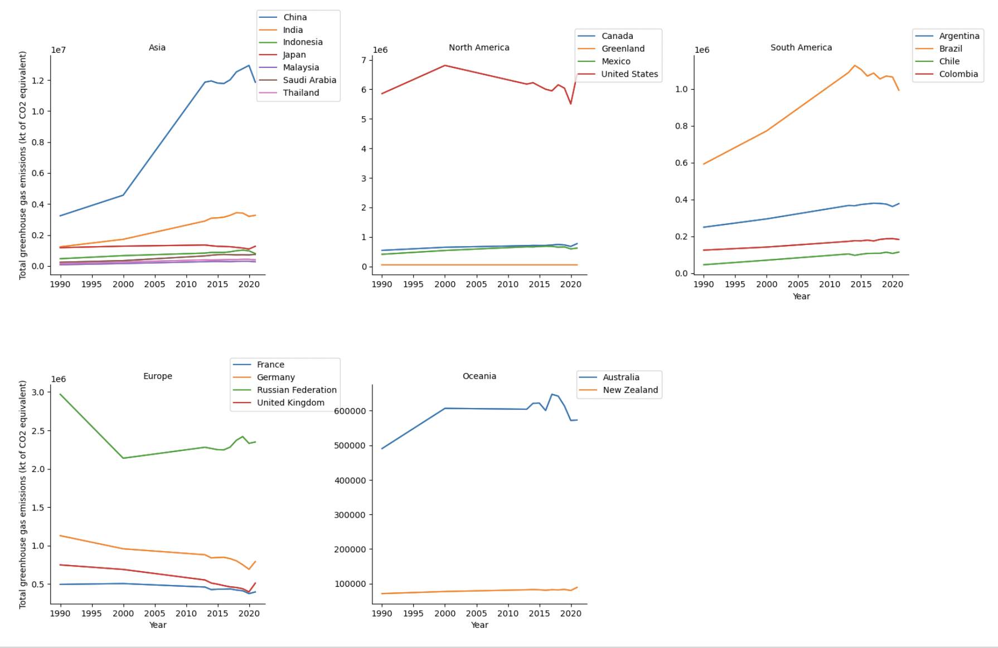
Trends of Total Greenhouse Gas Emissions (1990-2021)

Slide 12
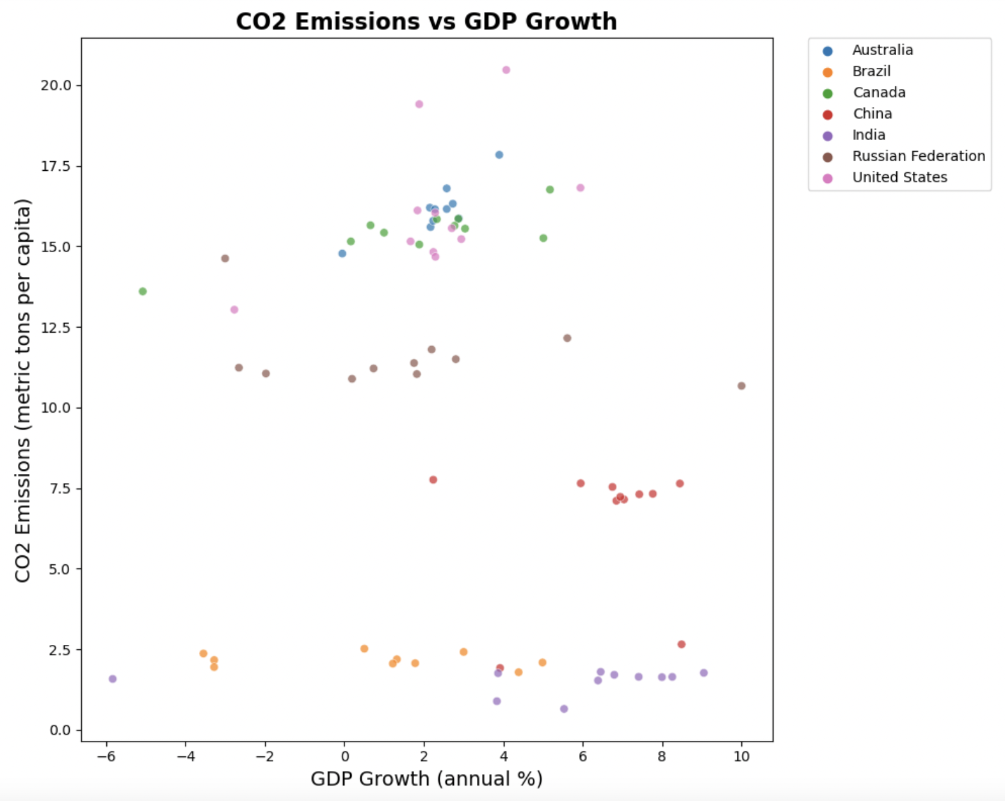
The relationship between GDP growth and CO2 emissions

Slide 13
Action Recommendations
Implement environmentally industrialization strategies
Promote energy efficiency
Diversify the energy structures
International cooperation and sharing of best practices

Slide 14

3. Electricity Access Analysis
Form the economy level
For the environmental level
From the society level

Slide 15
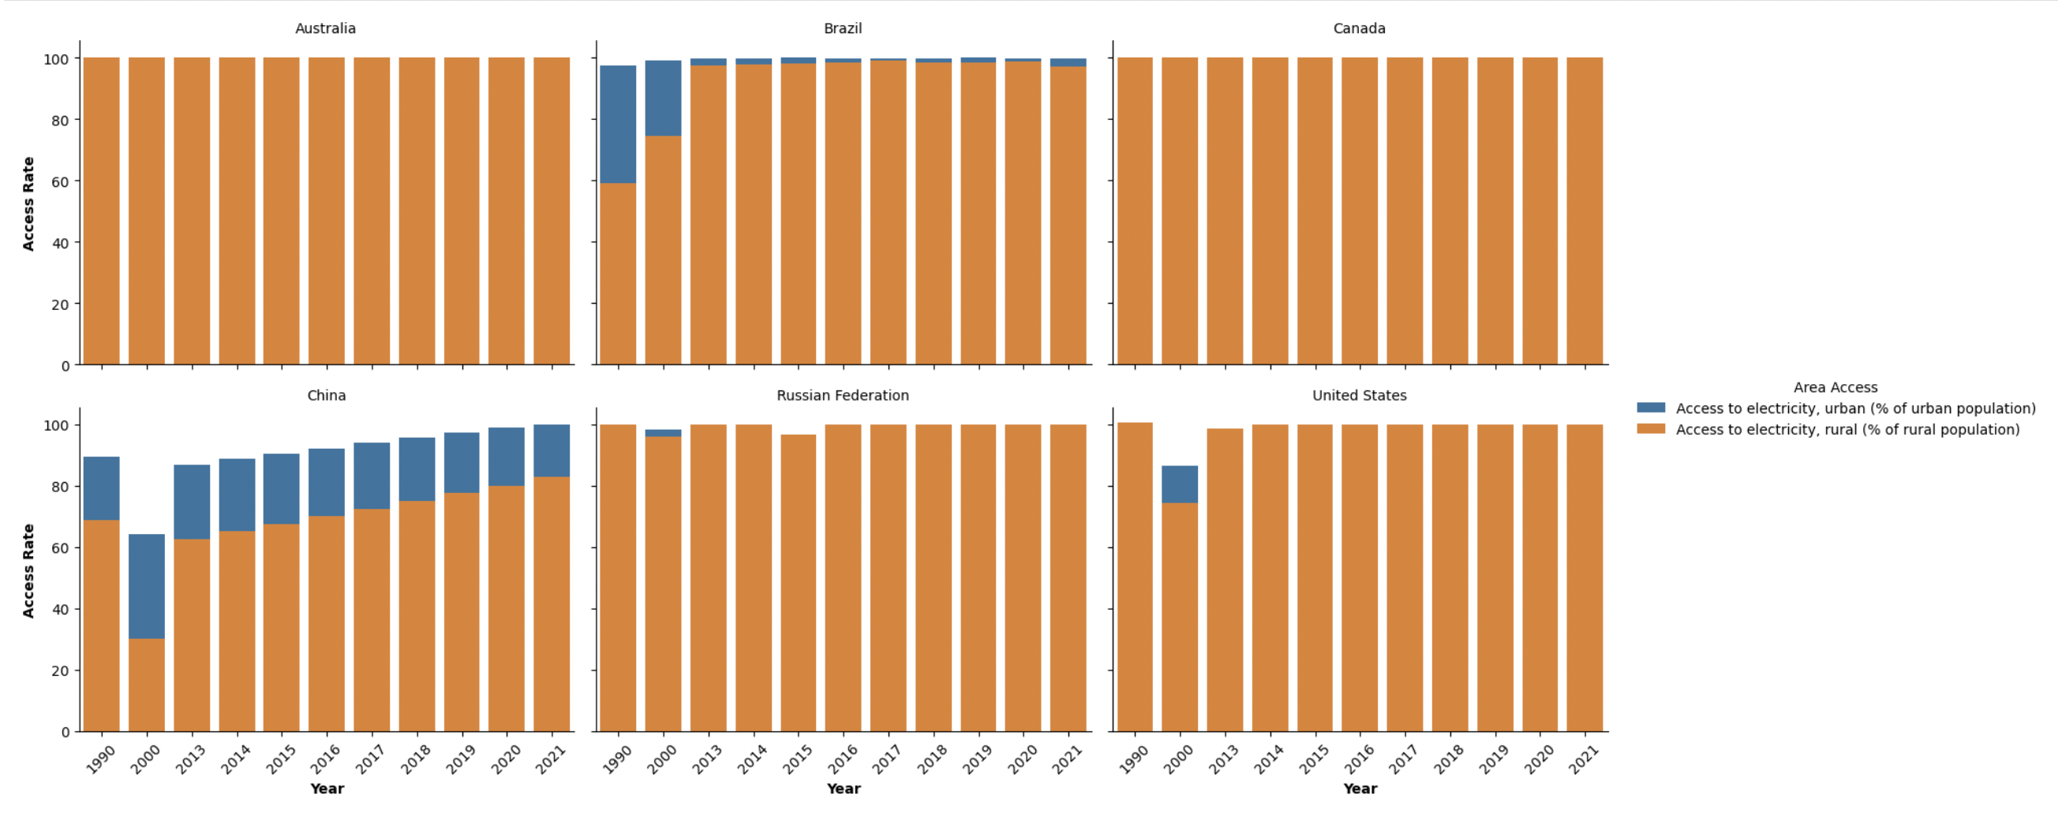
Electricity Access Disparity between Rural and Urban Populations

Slide 16
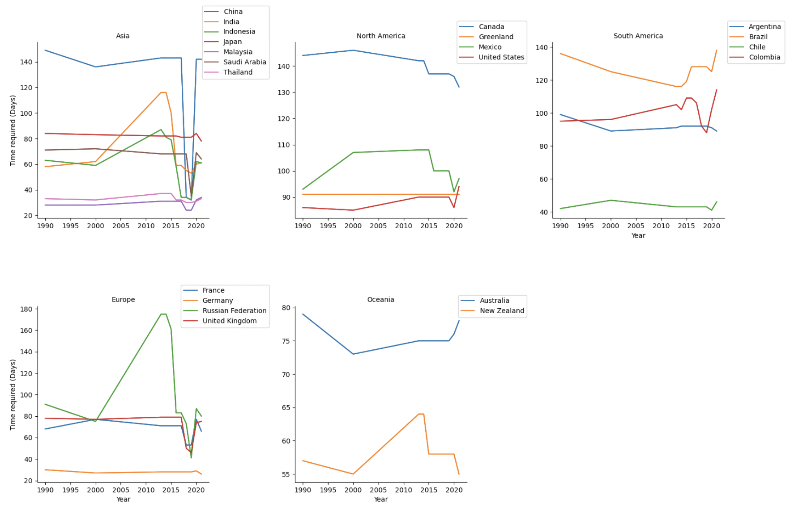
Efficiency of electricity infrastructure development

Slide 17

Conclusions
Energy Consumption
Environmental Impact
Electricity Access

